Slide 1
Kentucky County Clerk’s
Association Conference
November 2021
Department for Local Government
Office of Financial Management & Administration

Slide 2
Counties Branch Your Local Gov. Advisor
Tom Dobson
Buffalo Trace
KIPDA
Lincoln Trail
Northern KY

Slide 3
Counties Branch Your Local Gov. Advisor
Jaarad Taylor
Big Sandy
Bluegrass
FIVCO
Gateway
KY River

Slide 4
Counties Branch Your Local Gov. Advisor
Lisa Dale
Barren River
Cumberland Valley
Lake Cumberland

Slide 5
Counties Branch Your Local Gov. Advisor
Will Summersett
Green River
Pennyrile
Purchase

Slide 6
Counties Branch Your Local Gov. Advisor
Wendy Thompson
County Official’s Training Program

Slide 7
Budget Process
October / November
Letter from State Local Finance Officer
Reminder to begin preparing budget
The Official Fee Office Budget Form
Fee Office Budget Forms on the Website
www.kydlgweb.ky.gov
Consumer Price Index estimate –
No longer provided

Slide 8
Budget Schedule
The Fiscal Court must approve your Budget by January 15th
You should submit it prior to this date.

Slide 9
Approving Fee Office Budget
Approve as a whole
Without spending caps
Approve each line item
Put a spending cap on each line item
Order must state specifics of approval

Slide 10
Setting Maximum Amounts for Fee Offices Deputies and Assistants
KRS 64.530
The Fiscal Courts shall fix annually the maximum amount including fringe benefits which the County Clerk and Sheriff may expend for deputies and assistants.

Slide 11
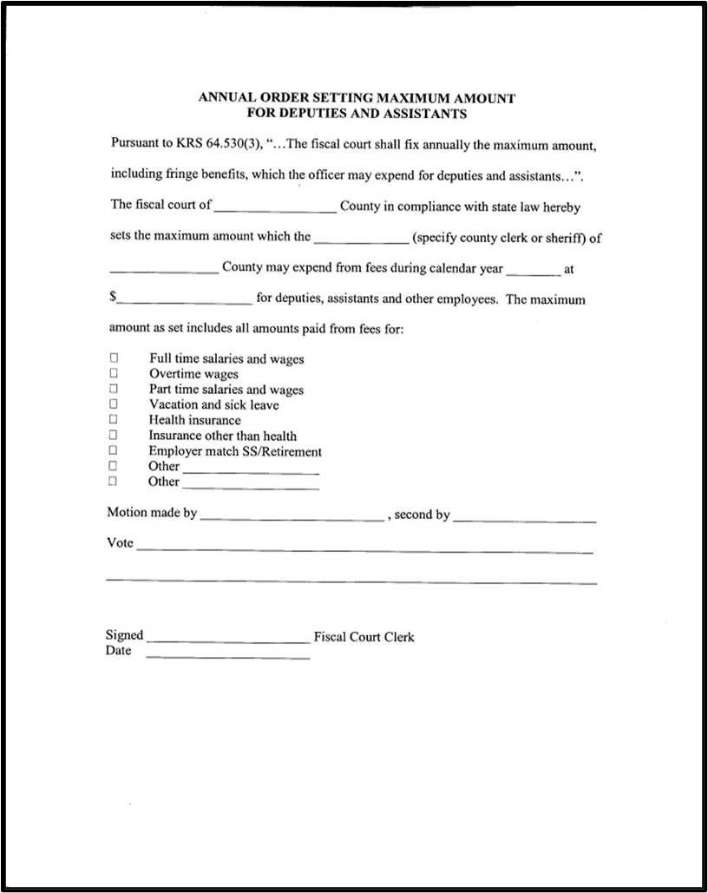
Clerk’s Annual Order

Slide 12
Approving Fee Office Budgets
Amount budgeted to receive from the Fiscal Court on line 4
If the Fiscal Court pays for an item out of the Fiscal Court budget, the same item should not be listed in line 4

Slide 13
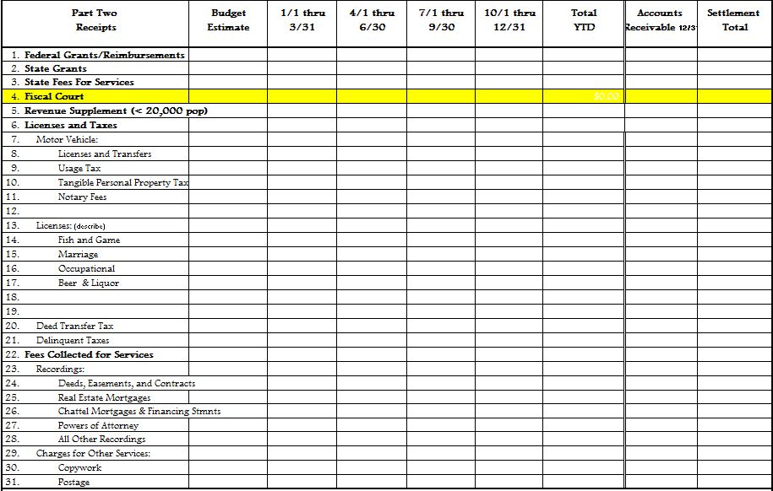
Clerk’s Budget

Slide 14
Fee Official Support
Fiscal Courts may support County Clerk’s expenses through the payments of claims presented to the Fiscal Court and paid from a properly budgeted line item in the county budget.
Lump Sum Payments (i.e. prior year excess fee reimbursement to the fee office) are prohibited.
KRS 64.710

Slide 15
Handling Public Funds
All accounting systems must comply with the cash basis of accounting
Pre-numbered three-part receipt should be issued for all receipts. – KRS 64.840
Bonding of all officials/employees who handle public fund for an amount covering the maximum amount they have in their control at one time.

Slide 16
Handling Public Funds
Advertisements for completive bids prior to purchases exceeding $20,000 – KRS 424.260
No bonuses, no payments for goods or services, and no contributions. – Section 3
Annual financial statement prepared – KRS 424.220
Books of original entry for receipts and expenditures and or utilization of daily cash check-out sheets-KRS 68.210

Slide 17
Handling Public Funds
Daily deposits intact into federally insured banking institution. – KRS 68.210
All investments must follow the Investment Policy adopted by the agency. – KRS 66.480
Personal funds kept separate from public – KRS 64.850
Monthly bank reconciliation – KRS 68.210

Slide 18
Handling Public Funds
Disbursement by check only – KRS 68.210
Fixed Assets documentation (inventory)
Preparation of an annual budget showing estimated receipts and expenditures – KRS 68.210
Interest Bearing Accounts

Slide 19
Clerk Fee Accounting
Prescribed by the State Local Officer
Cash Basis of Accounting
Requires budget approval by the Fiscal Court
Quarterly Financial Statement submitted to the State Local Finance Officer.

Slide 20
Clerk Fee Accounting
Books of Account
Three-part receipts
Daily Cash Checkout Sheet
Receipt Journal
Check Distribution Register
Expenditure Ledger
Quarterly Financial Statement

Slide 21
Receipt
Source document of record
Three-part
Pre-numbered
Original given to payor
Copy attached to daily checkout
Copy filed numerically

Slide 22
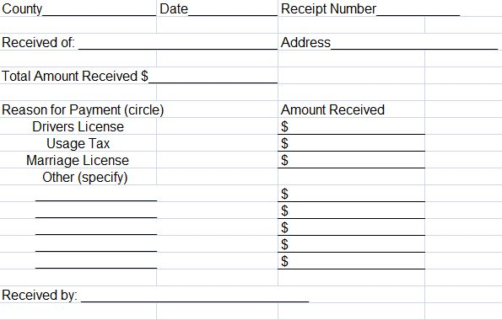

Slide 23
Daily Cash Checkout Sheet
Daily Summary of activity
Broken down into various categories
Receipt form totals are posted here
Daily deposits should equal the sum total of all daily cash checkout sheets.

Slide 24
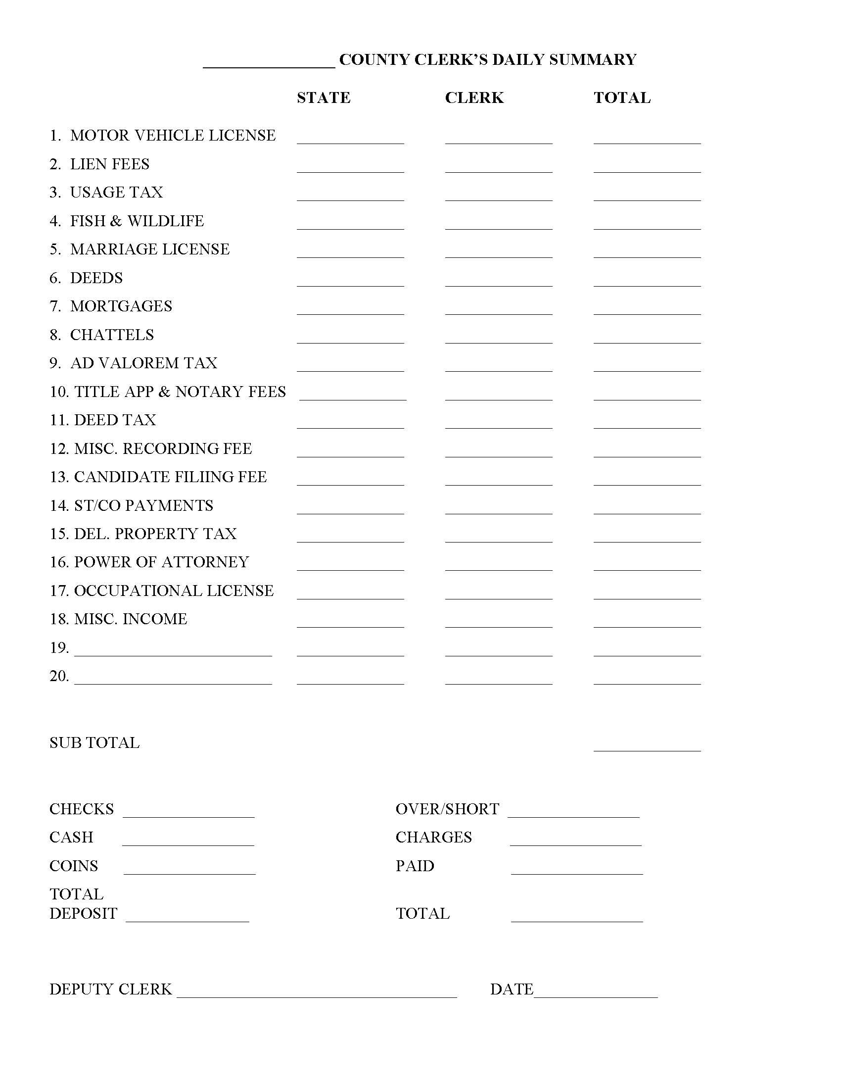

Slide 25
Receipts Journal
Records receipts by category
Daily recording of cash checkouts sheet data is posted here
Journal information is transferred to part 2 of the Quarterly Financial Statement

Slide 26
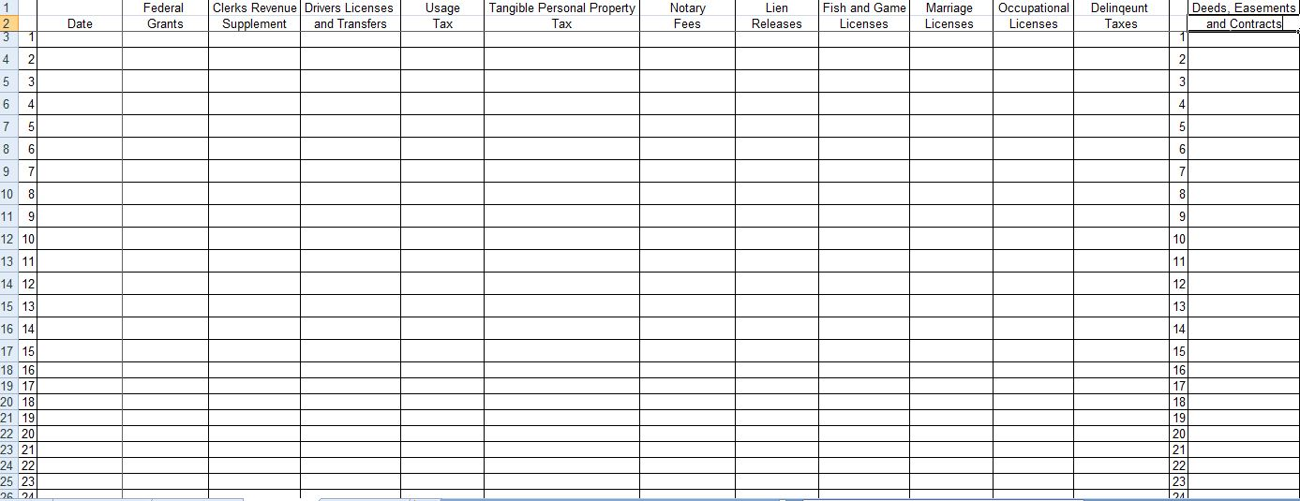
Expenditure Ledger

Slide 27
Expenditure Ledger
Chronological posting from check distribution register (checkbook register)
Breaks down expenditures by category
Expenditure Ledger information is transferred to part 3 of the Quarterly Financial Statement

Slide 28
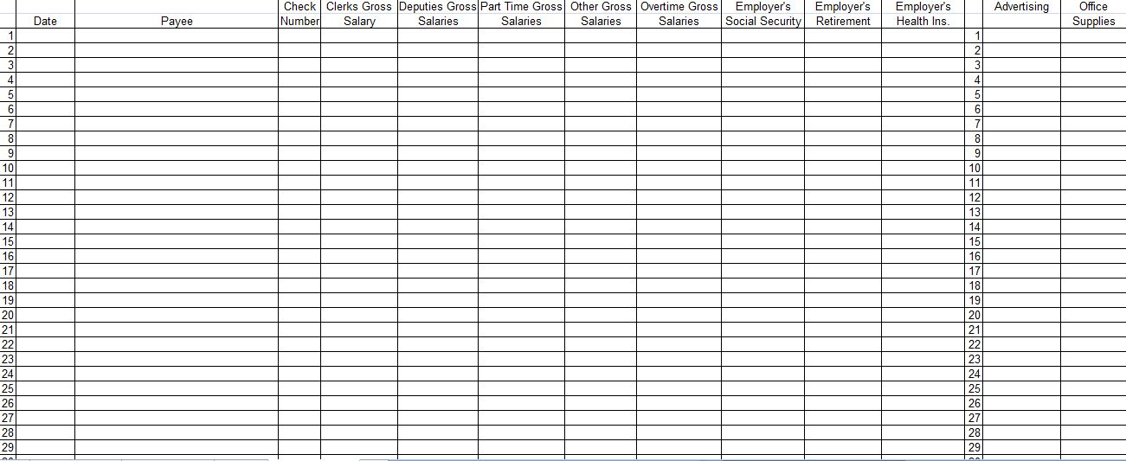

Slide 29
Budget & Quarterly Report

Slide 30
Quarterly Financial Statement
Cumulative Report
Due 30th of the month following quarter

Slide 31
Quarterly Financial Statement
Four Parts
Summary & Reconciliation
Receipts
Disbursements
Liabilities
Long Term Debt
Example: Vehicle/Purchase

Slide 32
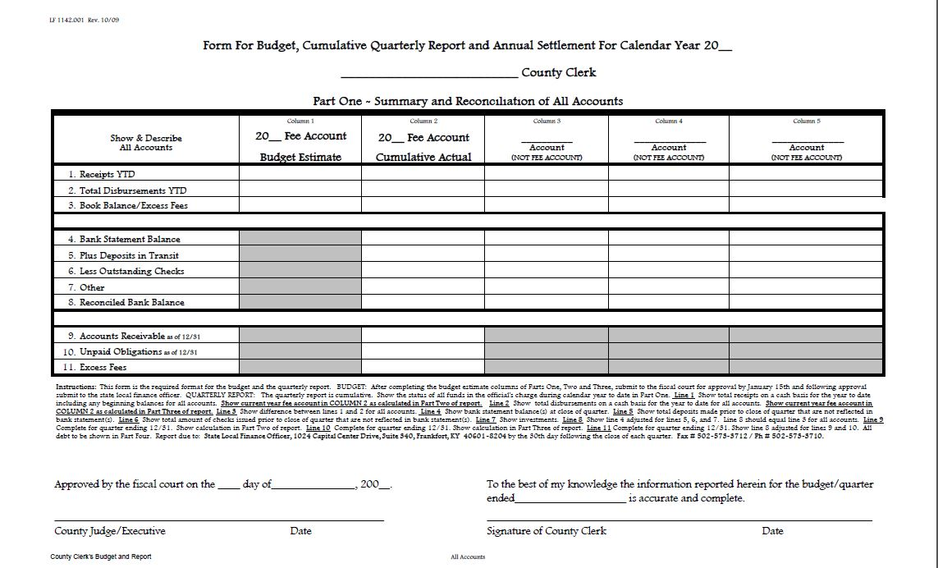

Slide 33
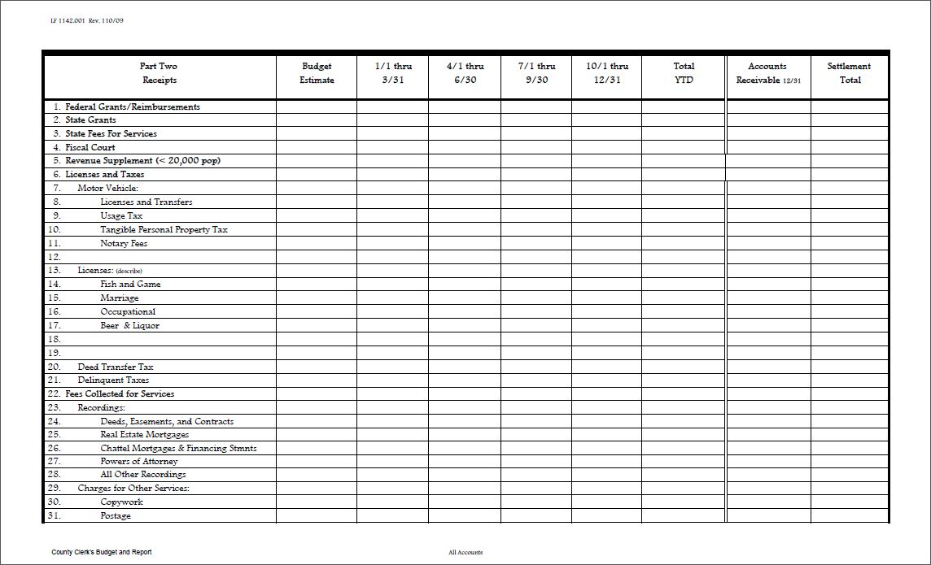

Slide 34
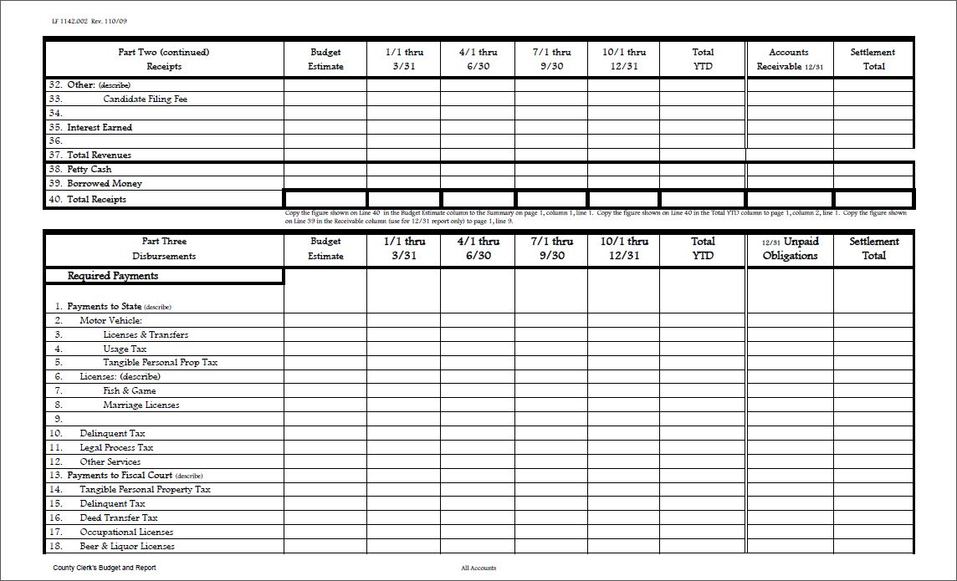

Slide 35
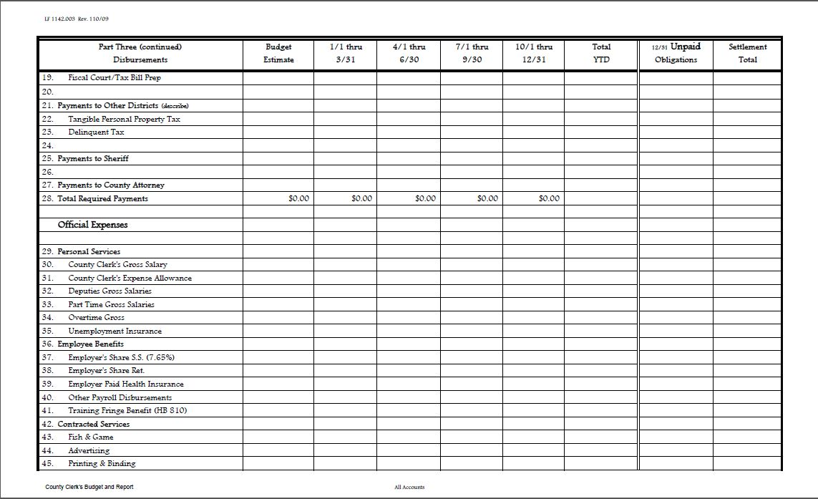

Slide 36
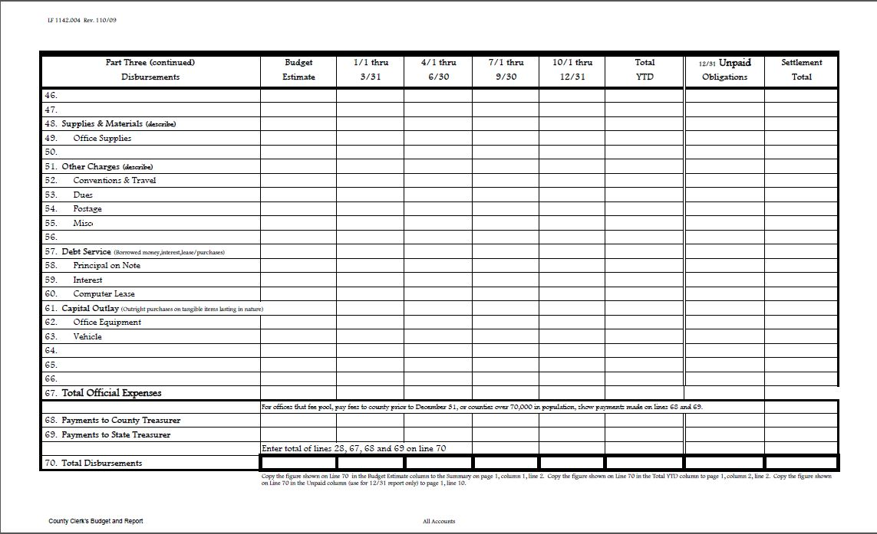

Slide 37
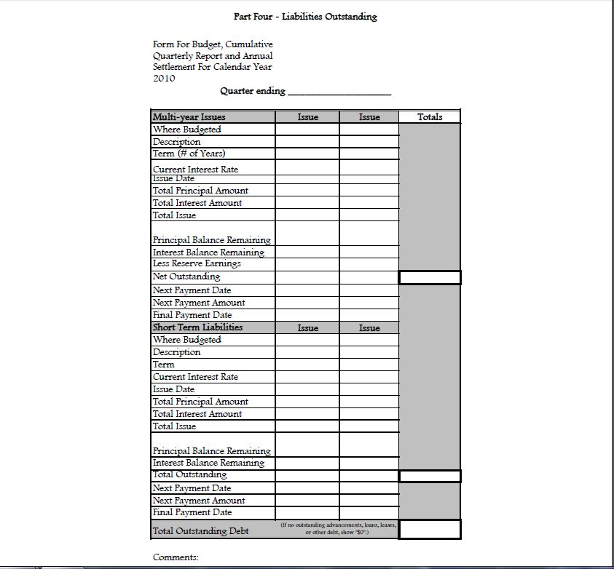

Slide 38
Your Budget / Quarterly Report
What Do We Look For ???

Slide 39
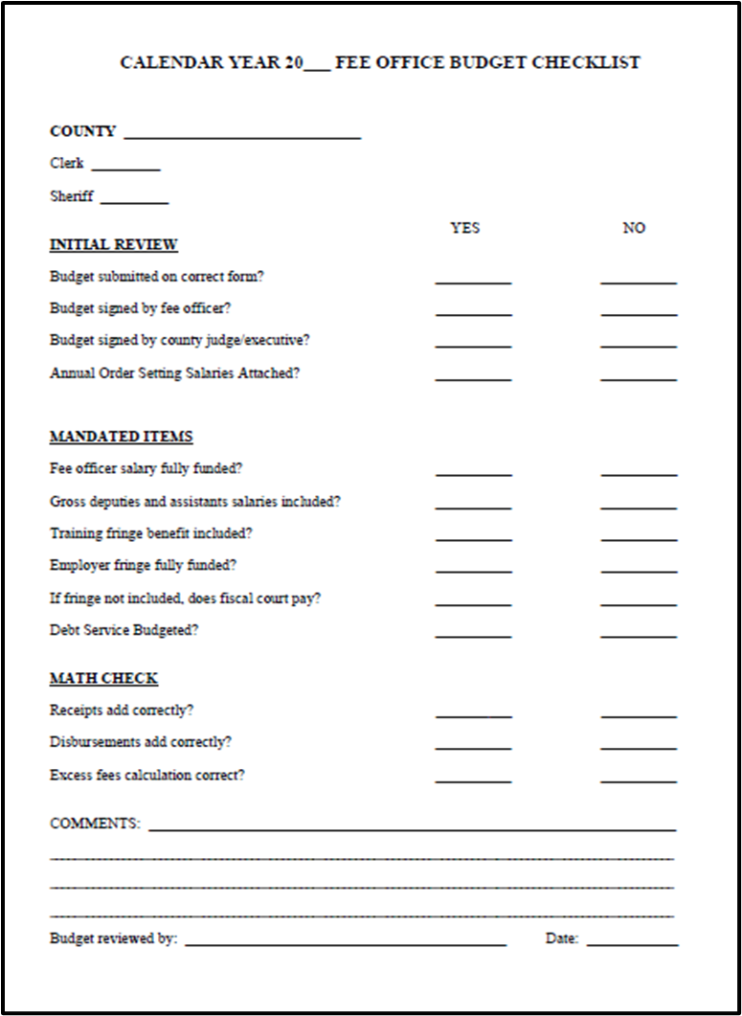

Slide 41
Common Errors
Fee account is “force balance” to incorrect data
Account bank reconciliation not shown
Book Balance and Reconciled Bank Balance do not agree
Year-to-Date Column not completed and totaled
Part Four, Liabilities Outstanding sheet is missing or incomplete

Slide 42
Common Errors
Report not signed by the fee official
Basic math errors
Figures not recorded in the budget estimate section of receipts and disbursements
Report not shown as cumulative amount on Part One, column 2

Slide 43
Check Sheets
Both the Budget and Quarterly Report Check Sheets are available on our website
www.kydlgweb.ky.gov

Slide 44
Questions
Department for Local Government
Office of Financial Management & Administration
100 Airport Road
Frankfort, KY 40601
www.kydlgweb.ky.gov
1-800-346-5606
Fax: 502-227-8691

Slide 45
County Elected Officials Training Incentive Program

Slide 46
Online Training Guidelines
All approved training will be listed on your training page under relevant upcoming courses. ONLY web-based training listed on this page will be accepted.
You must attend the entire course with the camera on. If they cannot see you, the training will not count.
Not all association training is approved for everyone. Make sure you check!

Slide 47
Reporting Your Attendance
For online training, your trainer will submit your hours. You will still need to double check that the hours are correct.
Courses for UK Transportation Center – Please forward your certificate to me.
Proof of an official’s training attendance should be submitted to our office within 60 days of completing the training. (109 KAR 2:020 Section 3(8)). This pertains to both web-based and in-person.

Slide 48
Reporting In-Person Attendance
For Proof of Attendance (POA) forms - Always make sure your “Name”, “County” and “Office” are legible on your attendance form and you have CORRECTLY INITIALED the form before submitting it. Send documentation by mail or e-mail. NO PICTURES
Ultimately it is the responsibility of the official to make sure their attendance information has been turned into DLG in a timely basis.

Slide 49
How To Access Your Training Page
Go to the DLG website http://kydlgweb.ky.gov.
You will see a list of links that take you to the different areas of our agency.
Second row, 3rd button is the County Officials Training Program Link.

Slide 51
Reports and Forms
Below are reports and forms that officials participating in the County Elected Officials Training Program will utilize. To view the corresponding report or forms click the heading of each section. County Elected Officials Training Program Participation Form (Adobe 125 KB) Elected or appointed officials who wish to participate in the County Elected Officials Training Program will need to complete and submit the County Elected Officials Training Program Participation Form before they will be included in the program. Newly elected or appointed officials who wish to participate in the County officials training program will need to complete this form and submit it to our office in order to be enrolled in the training incentive program.

Slide 52
Reports and Forms
Individual Training Records By clicking the link above, program participants may view their individual training record online by entering their name, county, office or any combination thereof. Training Approval Request Form (Adobe 136 KB) For training events not listed in the Upcoming Approved Training Events, approval may be requested by completing and submitting the Training Approval Request Form, along with a detailed event agenda listing all training times and indicating any breaks and meals during the training event. To complete this form click the link in the heading listed above this section. For questions concerning the County Elected Officials Training Program please contact Wendy Thompson, Training Coordinator.

Slide 53
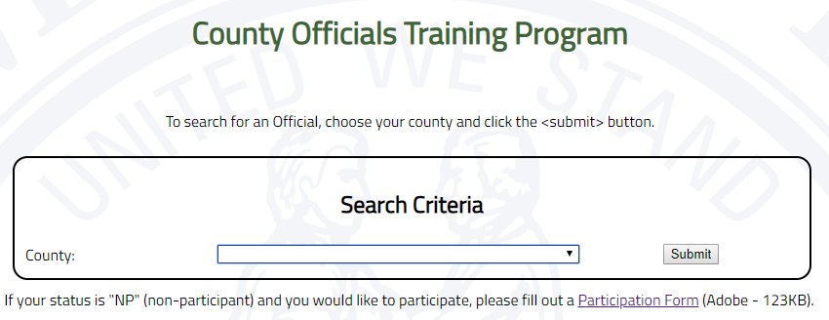

Slide 54
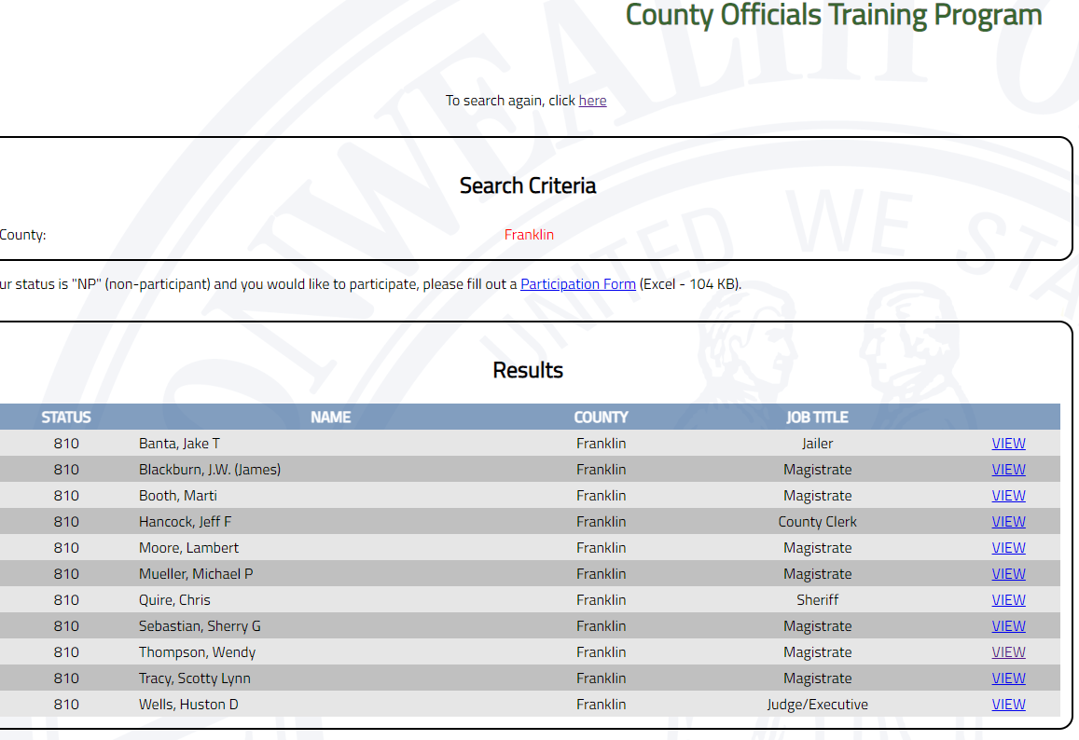

Slide 55
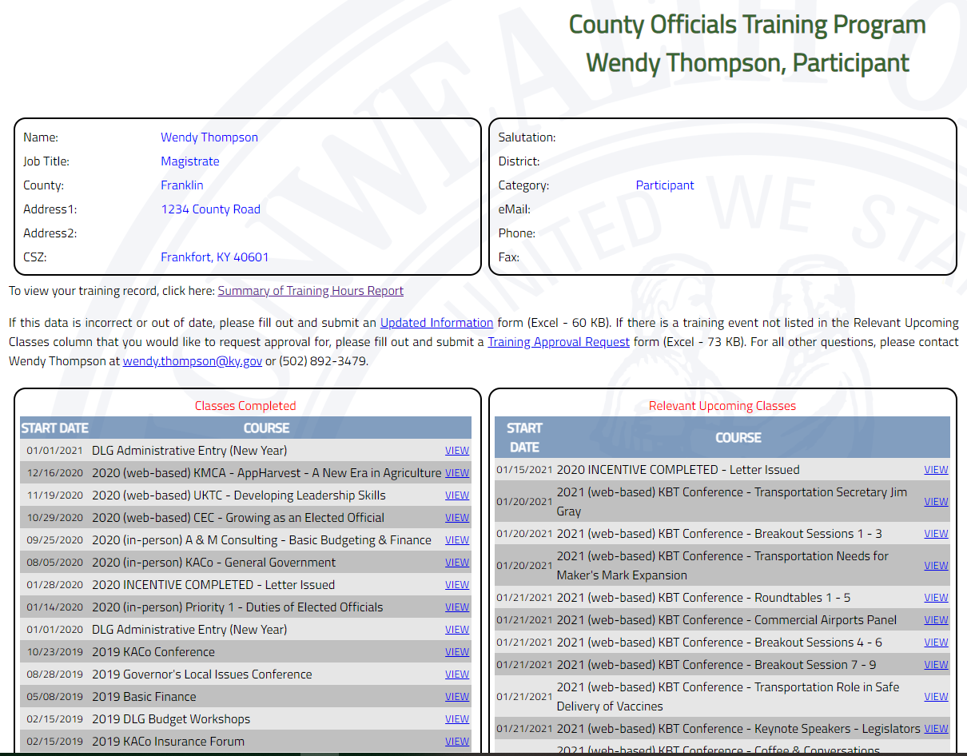
Your Summary Page

Slide 57
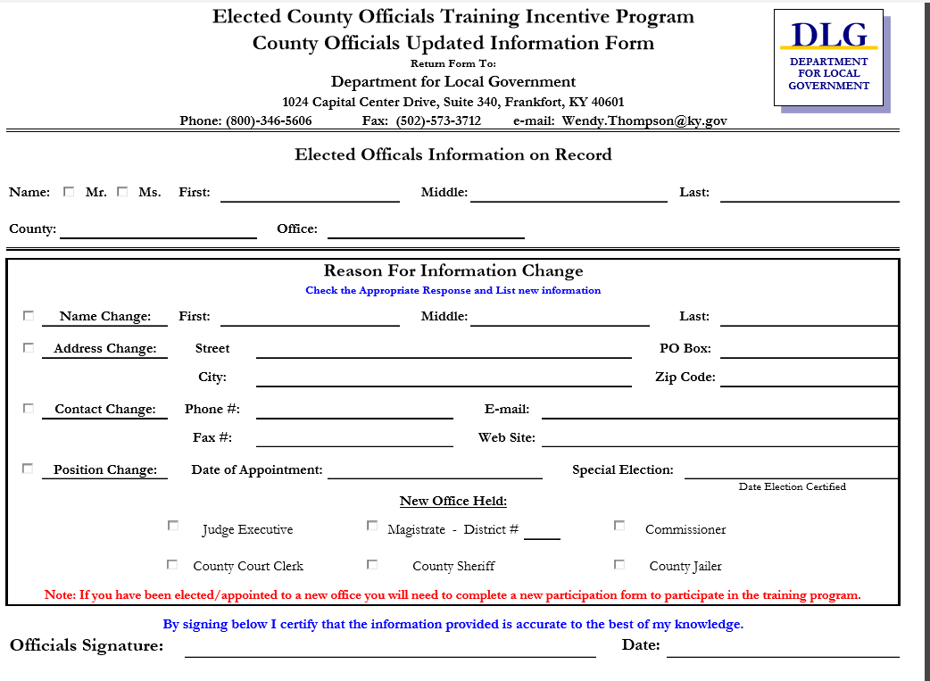
Is Your Contact Information Correct?

Slide 58
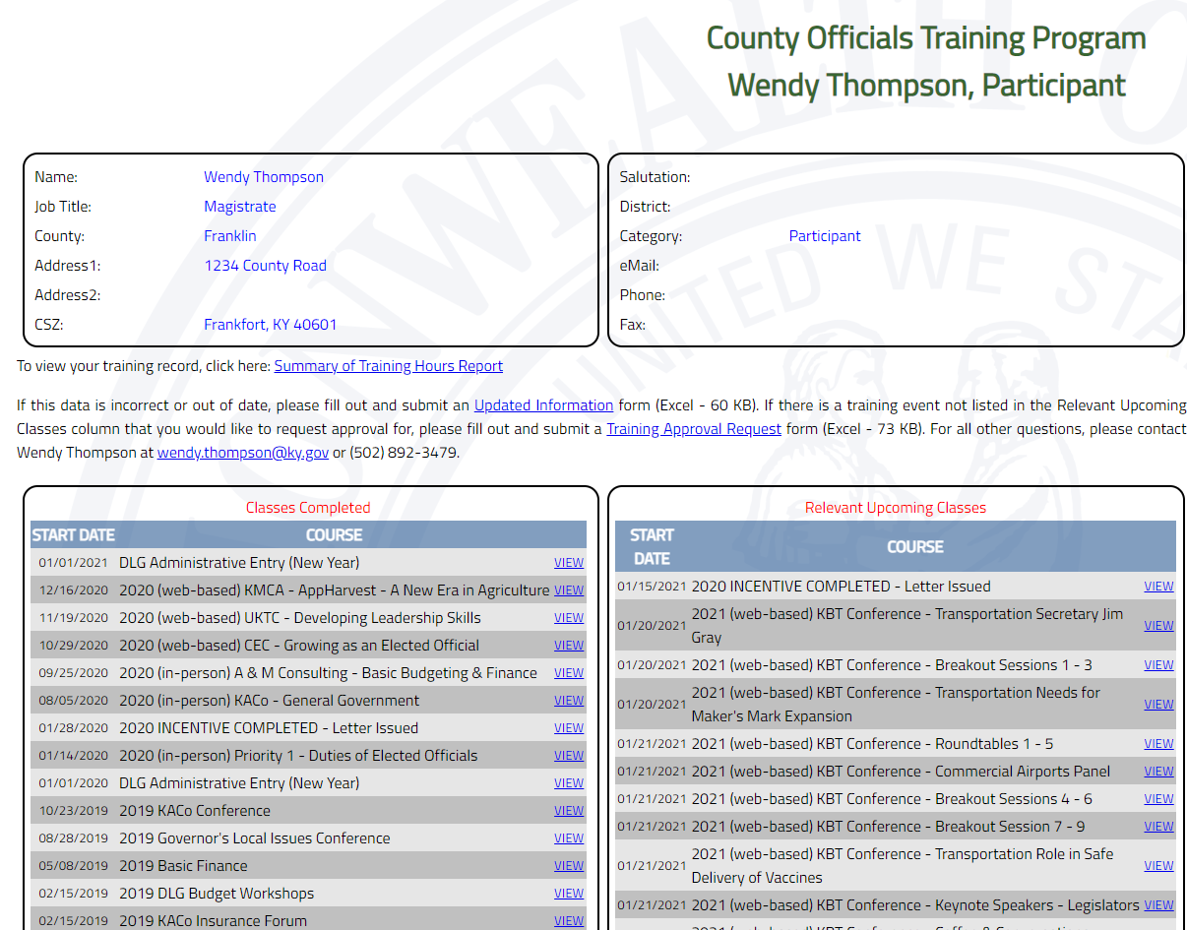

Slide 59
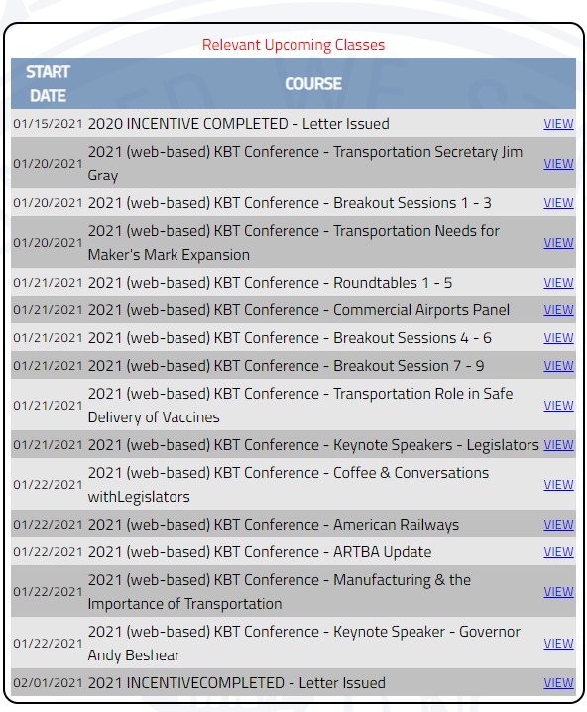
Relevant Upcoming Courses

Slide 60
Your Training Record
Reflects what you have certified that you attended on your Proof of Attendance Forms (POAs). So fill them out accurately!
If you need to leave the session to make a phone call, please make it very brief or mark on your POA for the amount of time you left the session.
Your record is Subject To Open Records Requests!!! As are all of your Proof of Attendance Forms.

Slide 61
Questions
Department for Local Government
Office of Financial Management & Administration
100 Airport Road
Frankfort, KY 40601
www.kydlgweb.ky.gov
1-800-346-5606
Fax: 502-573-3712

